Slide 1
Visual Planning

Slide 2
Examples
Notes:
What is OpenAgile?
How does OpenAgile work?
Why should your organization use OpenAgile?

Slide 3
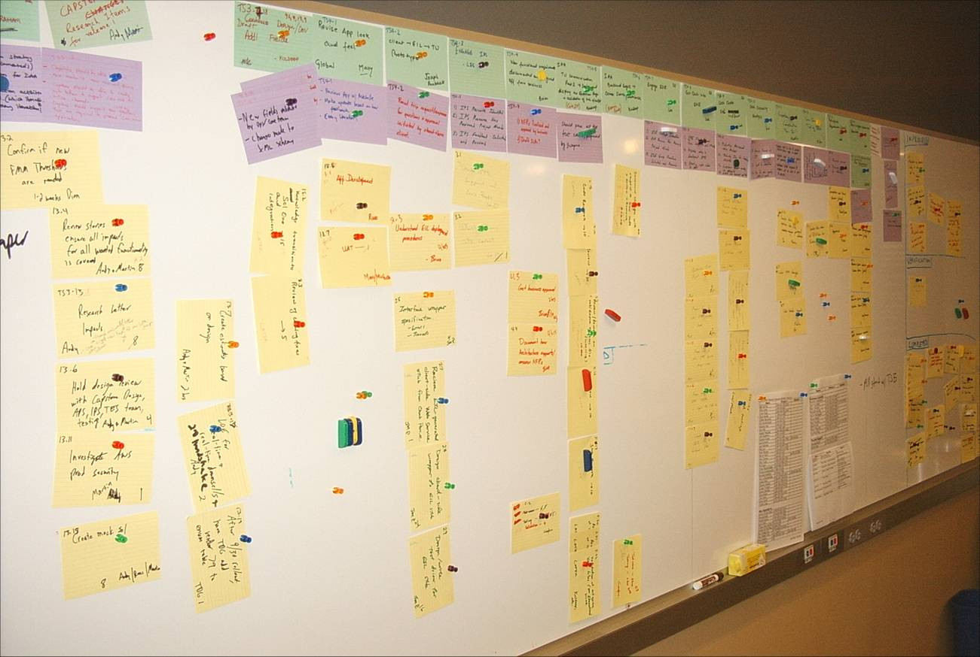
Example One
Notes:
Measure from customer request to time customer request is satisfied by value delivered to customer.
For projects, this is measured from the time a project is proposed (not approved) to the time it delivered all required scope.
Question: how to handle known defects that are not resolved during the time of the project?
For operations, this is measured from the time a unit of work is started to the time it is finished.

Slide 4
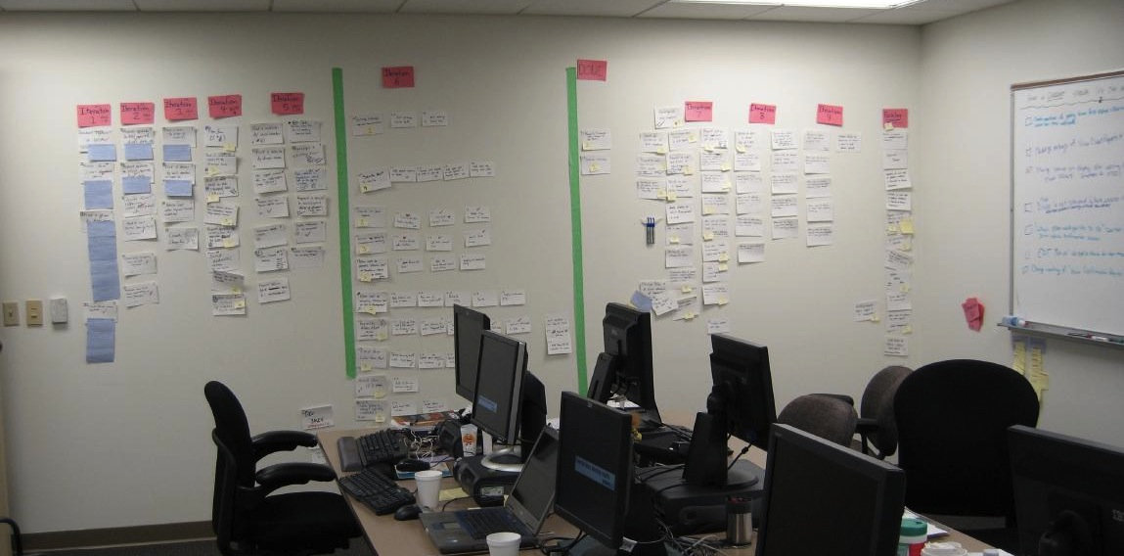
Example Two
Notes:
Measure from customer request to time customer request is satisfied by value delivered to customer.
For projects, this is measured from the time a project is proposed (not approved) to the time it delivered all required scope.
Question: how to handle known defects that are not resolved during the time of the project?
For operations, this is measured from the time a unit of work is started to the time it is finished.

Slide 5
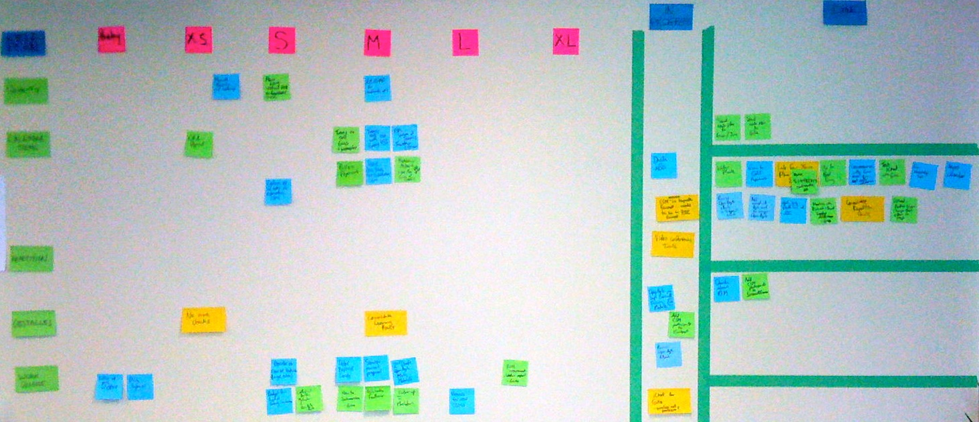
Example Three A
Notes:
Measure from customer request to time customer request is satisfied by value delivered to customer.
For projects, this is measured from the time a project is proposed (not approved) to the time it delivered all required scope.
Question: how to handle known defects that are not resolved during the time of the project?
For operations, this is measured from the time a unit of work is started to the time it is finished.

Slide 6
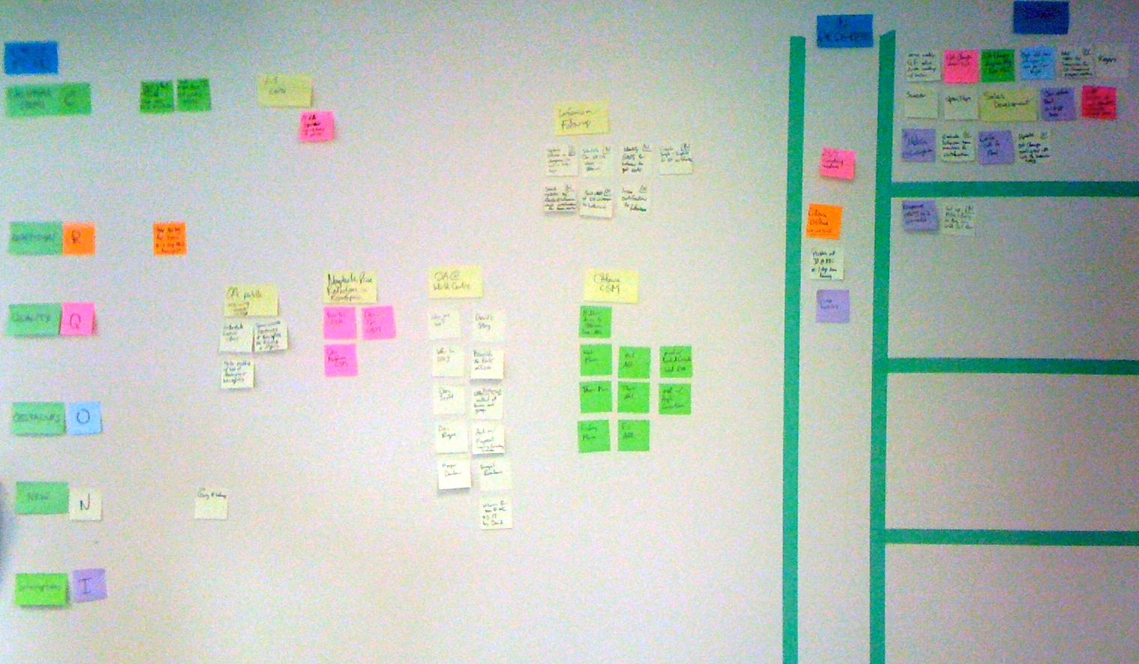
Example Three B
Notes:
Measure from customer request to time customer request is satisfied by value delivered to customer.
For projects, this is measured from the time a project is proposed (not approved) to the time it delivered all required scope.
Question: how to handle known defects that are not resolved during the time of the project?
For operations, this is measured from the time a unit of work is started to the time it is finished.

Slide 7
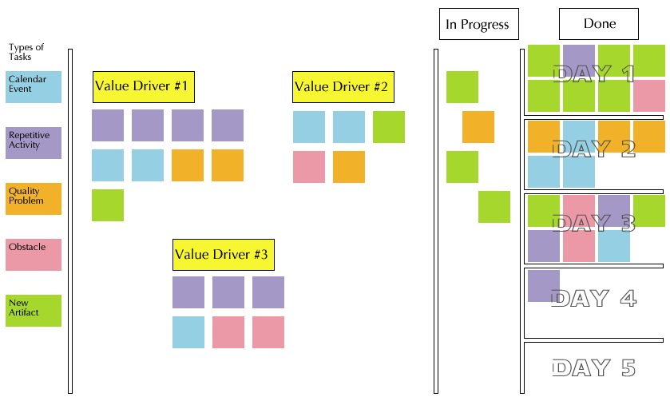
Diagram
Notes:
Measure from customer request to time customer request is satisfied by value delivered to customer.
For projects, this is measured from the time a project is proposed (not approved) to the time it delivered all required scope.
Question: how to handle known defects that are not resolved during the time of the project?
For operations, this is measured from the time a unit of work is started to the time it is finished.

Slide 8
O
Notes:
Any questions or comments?

